Slide 1
Trip Assistant Chatbot ( Tripzo )
Gauatm Jagish Chand Verma – 2220834
T.Y.BSc. Computer Science(sem V)
19th December 2023

Slide 2
INTRODUCTION
The trip assistant chatbot(Tripzo) is the android application which work like a virtual travel agent which help users to planned their trip in efficient manner And simplifying the process of booking and other queries.
Our chatbot (Tripzo) offer an alternative by using existing platforms like browser and messenger’s apps that almost everyone has on their phone
and make it possible for users to receive notifications without downloading separate apps for each service during the trip and help the traveller to plan their trip easily.
In current scenarios the chatbots are capable of more than simply mimicking human speech and using of present scenarios. Some of them can be indistinguishable from a human. They have a personality, can perfectly understand human speech and can perform a wide variety of the tasks.

Slide 3
DBJECTIVES
Trip Assistant Chatbot Objectives:
Effortless User Experience
Time-saving for Customers and Company
Reduced Processual Workload
Enhanced Customer Care Channel
Cost-effective Solution
Customer Attraction & Retention
Increased Travel Company Sales

Slide 4
PURPOSE
Chatbot's Purpose in Tourism:
Personalized Customer Interaction
Efficient Trip Planning
Enhanced Customer Experience
Cost-effective Communication
Streamlined Information Access

Slide 5
SCOPE
In today’s world the scope of the chatbot is more because these chatbots helps the customer to plan his trip in very efficient manner. These chatbot is build or designed for the only specific information that user wants. The chatbot can automate the low-value tasks which are focusing on those that really add value to the both company and client
Our project aims at the automation in searching of hotel and planning for the trip.
It helps to gather the user requirements regarding the trip
Give Instant response
Easy to operate
Have good user interface
Gives the needed and proper information about the destinations.

Slide 6
SOFTWARE REQUIREMENTS
Front-End/GUI Tools: , XML (Extensible Markup Language)
DBMS/Back-End: Java
Languages: Java, Kotlin
Scripting Languages/API Creation: Brainshop API

Slide 7
HARDWARE REQUIREMENTS
Computer/Server:
A decent computer or server to develop and host the chatbot software.
Internet Connection:
A stable internet connection for development, testing, and hosting the chatbot.
Mobile Devices:
Optional: Mobile devices (smartphones, tablets) for testing the chatbot on different platforms (iOS, Android).
Development Tools:
IDE (Integrated Development Environment) or code editor suitable for the chosen programming language(s).
Testing Devices:
Devices to test the chatbot across different browsers, operating systems, or devices if the chatbot will be accessible via various platforms.

Slide 8
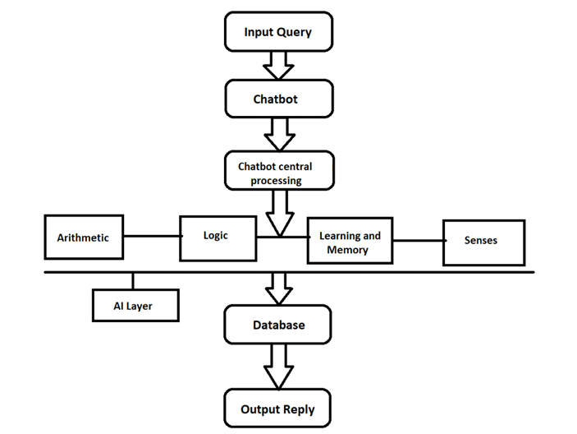
SYSTEM FLOWCHART

Slide 9
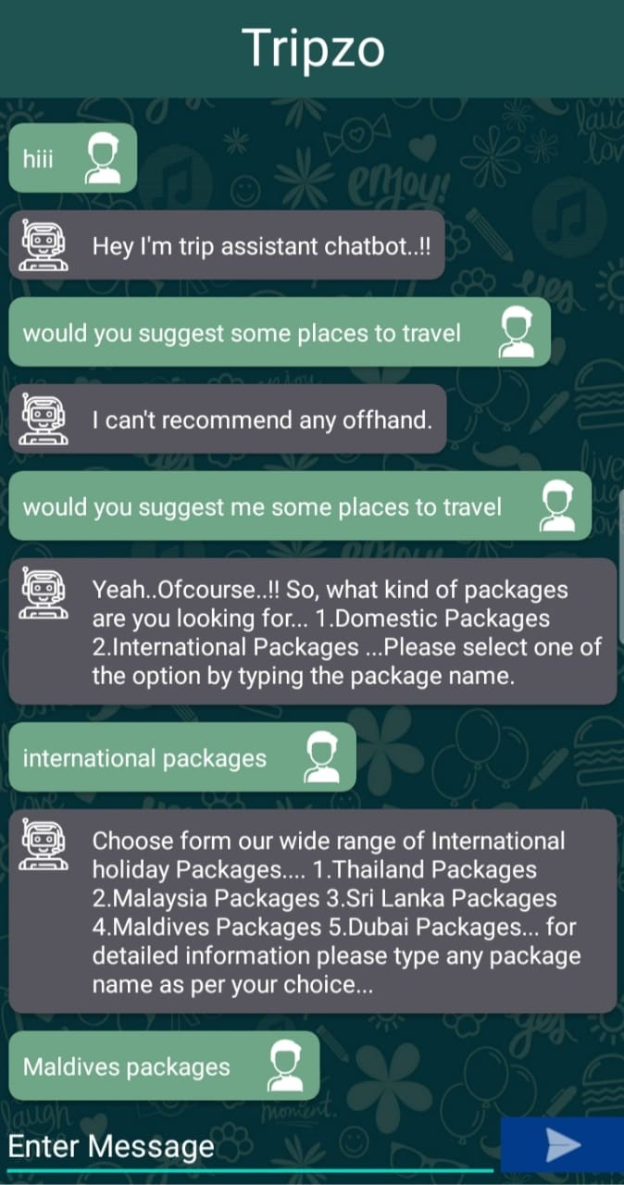
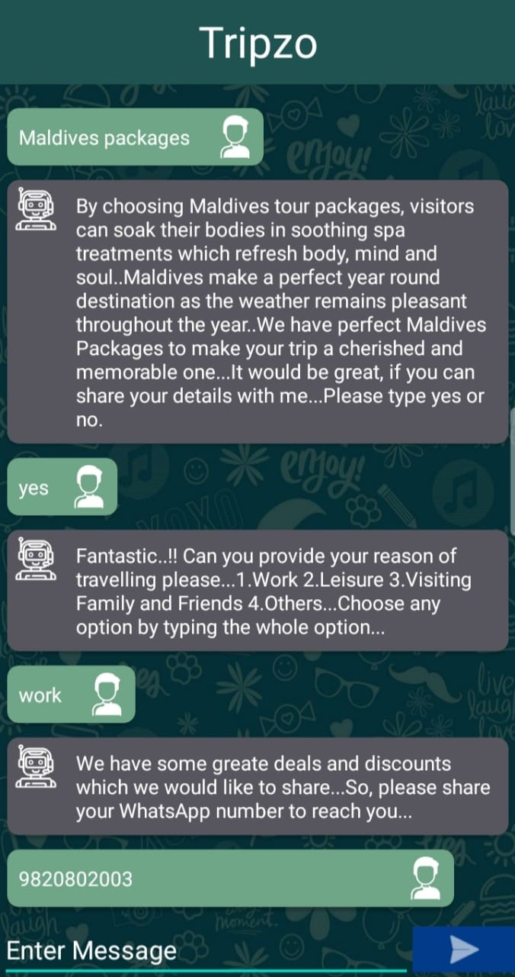
USER INTERFACE DESIGN

Slide 10
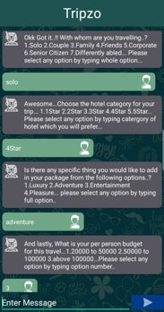
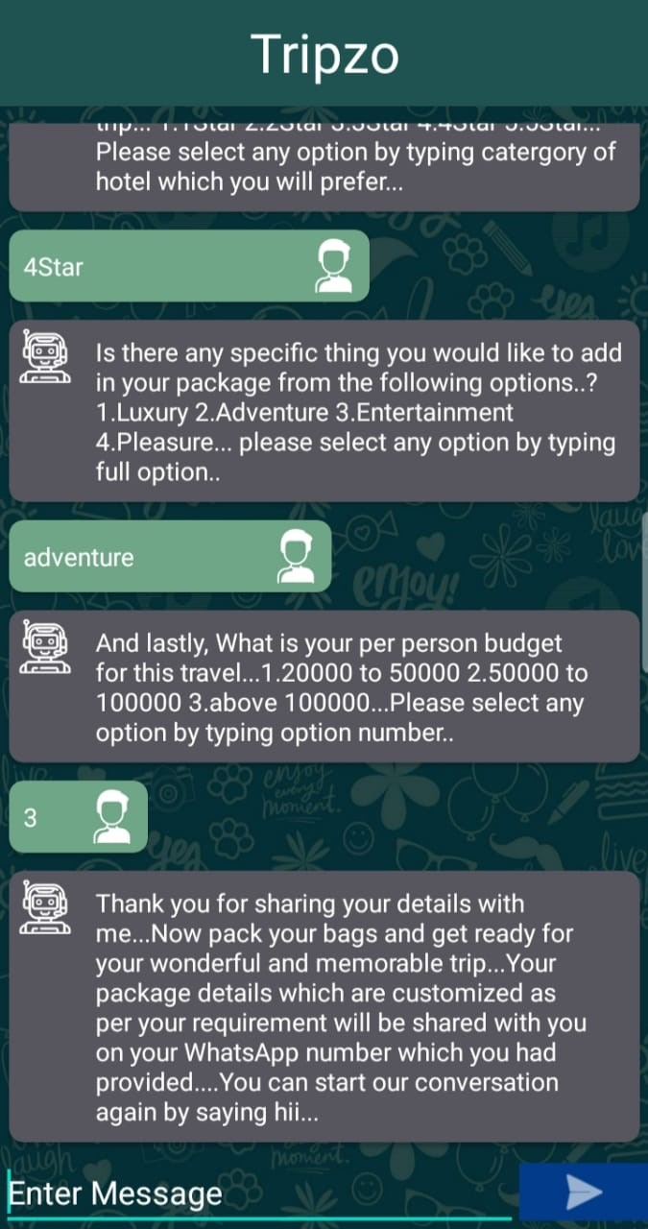
USER INTERFACE DESIGN

Slide 11
TESTING APROACHES
UNIT TESTING
Unit testing focuses on verifying the effort on the smallest unit of software-module
INTEGRATED TESTING
Data can be tested across an interface.
VALIDATION TESTING
It begins after the integration testing is successfully assembled
RECOVERY TESTING
Recovery testing is system that forces the software to fail in variety of ways and verifies that the recovery is properly performed.
SECURITY TESTING
Security testing attempts to verify that protection mechanism built into system will in fact protect it from improper penetration.
PERFORMANCE TESTING
Performance testing is used to test runtime performance of software within the context of an integrated system.
BLACKBOX TESTING
Black-box testing focuses on functional requirement of software.

Slide 12
FUTURE ENHANCEMENT
Integration with Other Platforms
Enhanced Personalization
Multilingual Support
Improved Understanding

Slide 13
REFERENCES
Bansal, Himanshu, and Rizwan Khan. "A review paper on human computer interaction." International Journals of Advanced Research in Computer Science and Software Engineering 8 (2018): 53-56.
Chatbot /Definition of chatbot in English by Lexico Dictionaries, 2019.
Abu Shawar, B., & Atwell, E. (2007). Chatbots: Are They Really Useful? LDV-Forum Band, 22, 29-49.
Ukpabi, D., Aslam, B., & Karjaluoto, H. (2019). Chatbot Adoption in Tourism Services: A Conceptual Exploration. in S. Ivanov, & C. Webster (Eds.), Robots, Artificial Intelligence, and Service Automation in Travel, Tourism and Hospitality (pp. 105-121). Emerald Publishing Limited. https://doi.org/10.1108/978-1-78756-687-320191006
Agostinho, D. (2016). Chat Bots: how could they impact the travel industry? Amadeus IT Group, Retrieved from: http://www.amadeus.com/blog/22/04/chat-bots-impact-travelindustry/, Date of Access: 3 July, 2017

Slide 14


